Slide 1

Managed Kubernetes Service in the Enterprise Daniel Selman- Kubernetes Consultant- Daniel.Selman@microsoft.com Sujit D’Mello- Principal Consultant- Sujit.DMello@microsoft.com

Slide 2

Agenda
Managed K8s- Best Practices
Monitoring
Security
Startup Scripts
Demo’s

Slide 3
Managed K8s- Best Practices
Projects with heavy dependencies ought to be packaged and deployed using Helm
Leverage Pipeline variables to deploy YAML to different environments
Deploy and Administrate your clusters through the API (or kubectl) - no SSH!
Establish naming conventions for all artifacts
Image pulls should be from private, managed container registries
Use managed databases for any back-end services

Slide 4
Monitoring
Logging
Configure verbose logging to stdout and stderr when developing your containerized applications
Log Rotation
Managed Kubernetes Services typically have defaults for log rolling
Custom tools can be used to configure log rolling for your requirements
Splunk
Daemonset that is built using the Splunk Universal Forwarder
Mounts the directory of container logs (stderr, stdout)
Forwards logs to Splunk Tenant

Slide 5
Security
Problem- Enterprises have requirements to install custom anti-malware on all Linux machines
How do you install custom software when you don’t have access to the nodes…?
You get creative with Kubernetes constructs

Slide 6
Anti-Malware DaemonSet
Solution Design
DaemonSets create a pod on each worker node in the cluster
Pods can mount Volumes on the host using the “hostPath” parameter
The init.d directory in /etc/ on the node tells the node what programs need to be run
Implementation
Create a DaemonSet mounting the root directory on the node to copy the anti-malware program & modify init.d to install and run it
Useful for other utilities that aren't easily deployed using a container

Slide 7
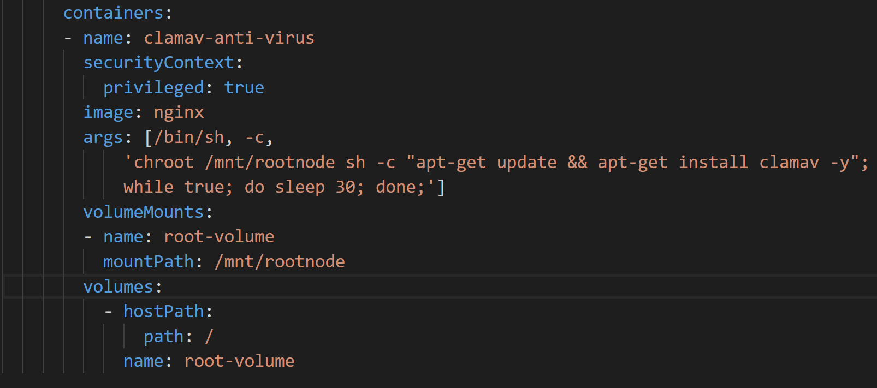
Anti-Malware DaemonSet

Slide 8
Startup Scripts
Many Enterprises have a bootstrapping process that must be configured on each image at runtime
Implementation
Store startup script (.sh or .cmd) in cloud storage
All applications include a small script which loads and runs this startup script before handing off control to the application entry point
Use secrets to store the URLs to the startup script

Slide 9
Bootstrapping Use Cases
External App Configuration
SSL enforcement for Cluster Traffic
Custom Host Files

Slide 10
Demos
Splunk
Log Rotate
Anti-Malware

Slide 11


